Slide 1
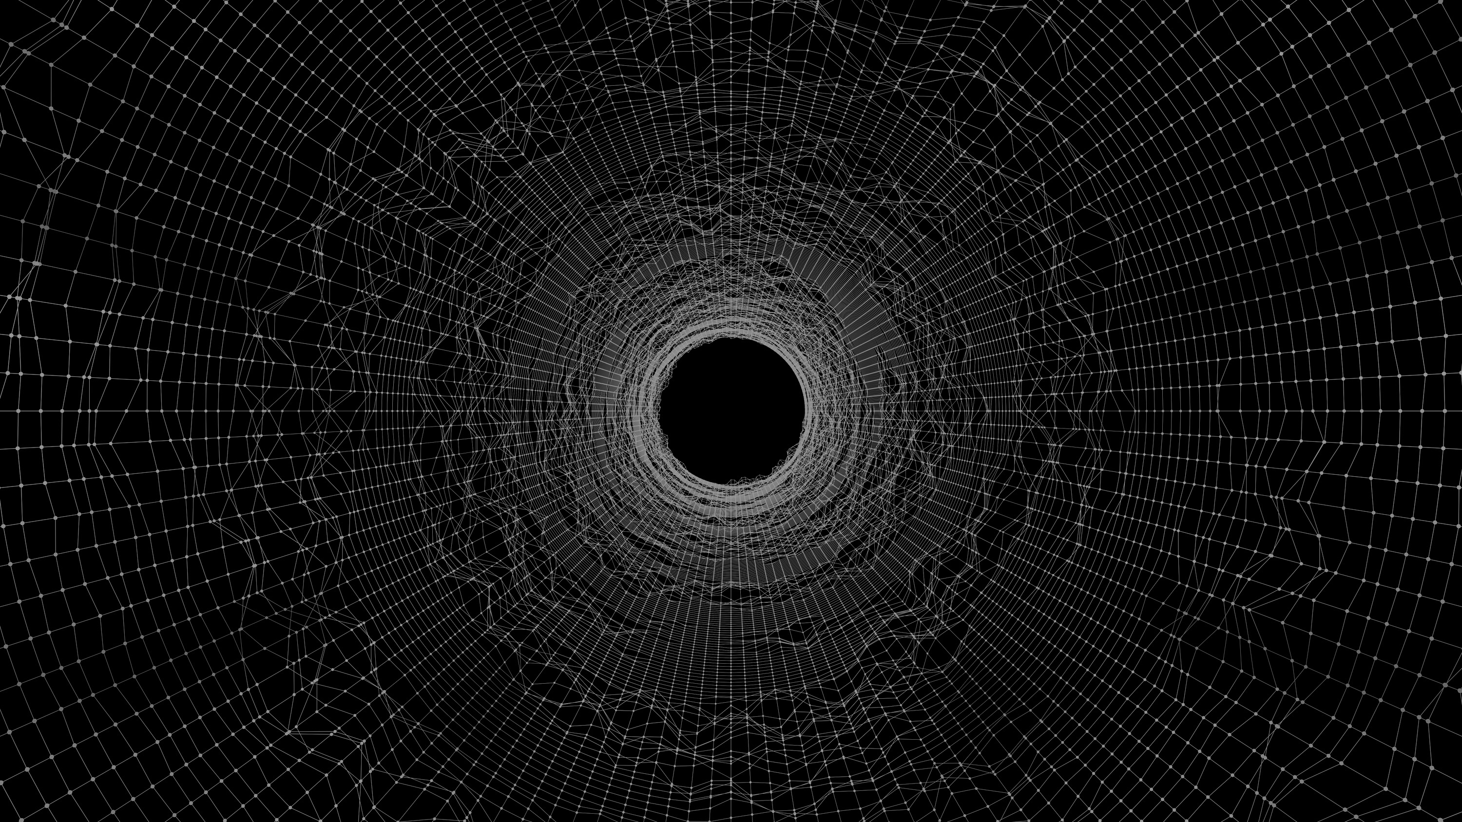







Mahatma Education Society’s
Pillai HOC College of Engineering and Technology
Department of Computer Engineering
ROAD HEALTH MONITORING SYSTEM
Team Members: (C-20)
Kaushal Bhoir (BE_B_02)
Sujwal Latke (BE_B_14)
Sarafaraj Shah (BE_B_47)
Guide -
Prof. Nikita Saindane

Slide 2

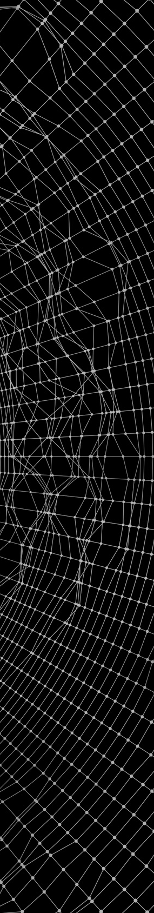



Table of Content
Abstract
Proposed System
Block Diagram
Introduction
System Requirements
Workflow Diagram
Literature Survey
Advantages
Results
Existing System
Disadvantages
Future Scope
Limitations
Some Eye Facts
Conclusion
Problem Statement
Some Eye Statistics
References

Slide 3



Abstract
The goal of our project is to design a Pothole detection System which assists the driver in avoiding potholes on the roads, by giving him prior warnings which can be like a buzzer or series of LED, which warn the driver in advance regarding road pothole.
The scope of the project lies , where the irregularity of the road affects public people.
This can be used in 4 wheeler , especially for ambulance drivers so that they could save many lives in time.

Slide 4

Introduction
As we all know, road safety is considered as one of the most important safety precautions that have to be taken to save our lives.
To ensure road surface quality it should be monitored continuously and repaired as necessary.
Well maintained roads contribute a major portion to the country’s economy.
One of the major problem is potholes on roads. The problem is more scary in rainy season.

Slide 5

Literature Survey
Title
Authors
Year
Merits
Demerits
Published
Pothole Detection System Using Yolo V4 Algorithm
Kshitija Chavan, Chinmay Chawathe, Vatsal Dhabalia, Amruta Sankhe
2022
Very quick to improve.
Not affected by noise.
May be subject to false positives and false negatives.
Detection of Roads Potholes using YOLOv4
2021
Improved signal to noise ratio with a better detection with noise.
Quick response time.
Sensitive to noise.
May be inaccurate.
Mohd Omar, Pradeep Kumar
Hyunwoo Song, Kihoon Baek and Yungcheol Byun
2018
Simple detection of edges and their orientation.
Detect object at distance.
May not detect all objects
Pothole Detection using Machine Learning

Slide 6
Literature Survey
Title
Authors
Year
Merits
Demerits
Published
Pothole Detection System using Artificial Intelligence
CH. Venkateswara Rao1, M Pavani2, Md Riyazuddin Ahammed3, D Sunil Varma4,P Bhami Reddy
2020
Very quick to compute.
Response time is fast.
Noise Sensitive.
Automatic Pothole Detection System
2019
Quick Response Time.
Cannot detect objects at distant.
High Complexity.
S Gayathri, Mamatha RG, Manasa B
Real-Time Pothole Detection Using Deep Learning
Anas Al-Shaghouri, Rami Alkhatib, Samir Berjaoui
2017
Detects nearby objects.
Produce false reading.
Accuracy affected by sunlight.

Slide 7
Existing System
In developing countries, the pavement pothole is often detected manually by inspectors of the municipal corporation during periodic field surveys.
Although this conventional method can help to acquire an accurate evaluation of potholes, it also features low productivity in both data collection and data processing. The reason is that one pavement inspector can only inspectless than 10 km per day.
With a large number of road sections needed to be inspected routinely, the automation of the pothole detection becomes a pressing need for transportation agencies.
The simplest method might be to collect photos of road damage and hazards taken by the participants and to upload them to a central server.

Slide 8
Limitations of Existing System
It requires more workforce.
Manual inspection in large cities will be complicated.
It is more time consuming.

Slide 9

Problem Statement
About 70% of the road accidents in India takes place due to improper construction of roads and due to unpredictable weather conditions in India.
Need of such a safety providing system is becoming essential for current scenario.
Every year we lose more than one lakh lives on Indian roads due to accidents and the proportion of the accidents due to potholes on the road is quite significant.
Number of accidents are more when the potholes are covered by water during monsoon.

Slide 10
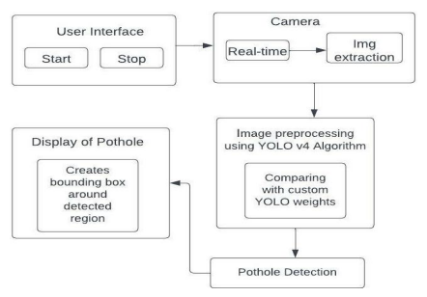
Proposed System
The proposed system works with the help of a very simple and user-friendly GUI which provides you with two options, “Start” and “Stop”, and helps you achieve real-time potholes detection using YOLO v4 algorithm.
When one selects the “Start” Option, the Camera switches on and live detection of potholes takes place. Now the camera keeps on recording while the YOLO v4 algorithm works in the back-end simultaneously.
When a pothole is detected, it predicts a bounding box around it. The bounding box consists of a Box Label and Predicted Accuracy Percentage where Accuracy Percentage refers to the percent of how accurately a pothole is detected. Whatever number of potholes are detected in each image gets reflected on the console output.
As you select the “Stop” option, the system exits the GUI and thus the detection process stops.

Slide 11
System Requirements
HARDWARE REQUIREMENTS
Laptop or PC:
Processor-Intel(R) Core(TM) i5-9300H CPU @ 2.40GHz 2.40 GHz
RAM-8.00 GB
System type-64-bit operating system, x64-based processor
15GB Free Storage Space
2GB VRAM
2. Camera:
SOFTWARE REQUIREMENTS
Visual Studio
Any Operating System
Chromium Based Browser
Python IDLE

Slide 12

Advantages
Very quick to improve.
Not affected by noise.
Improved signal to noise ratio with a better detection with noise.
Quick response time.
Simple detection of edges and their orientation.
Detect object at distance.

Slide 13
Disadvantages
Produce false reading.
May be inaccurate.
May not detect all objects.

Slide 14
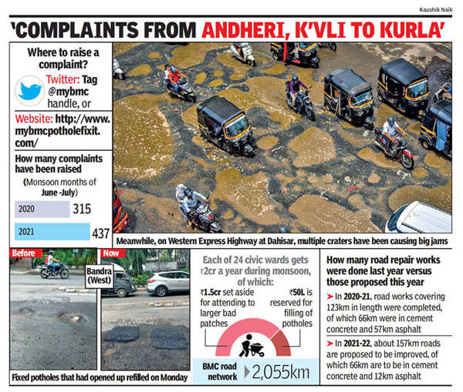
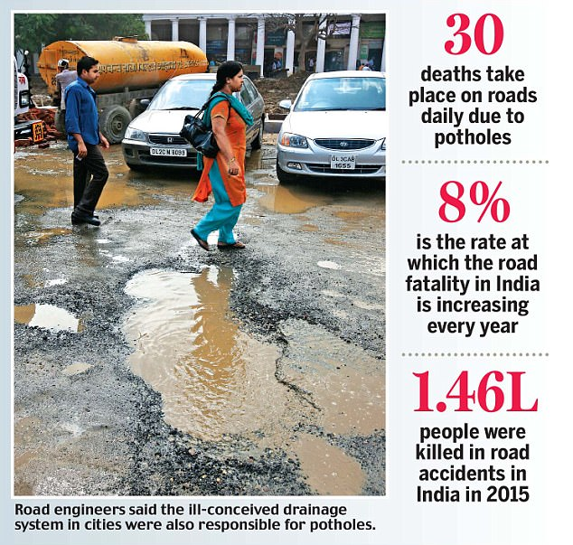
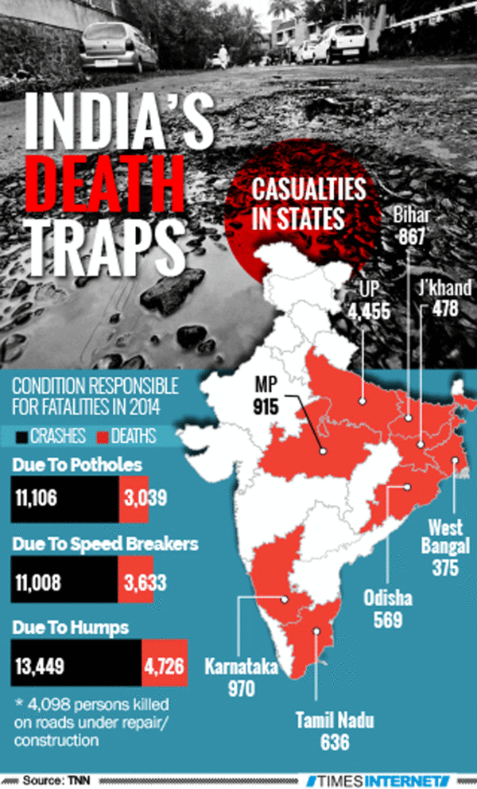
Some Eye Facts

Slide 15
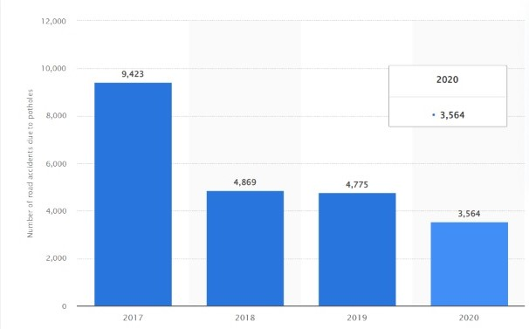
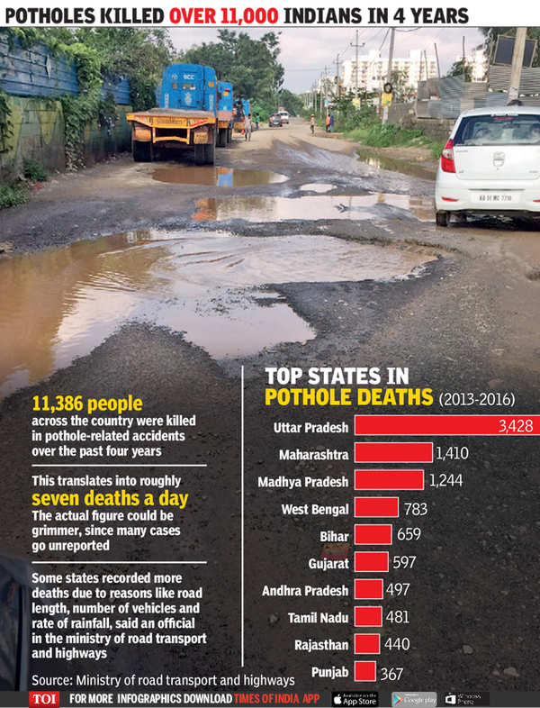
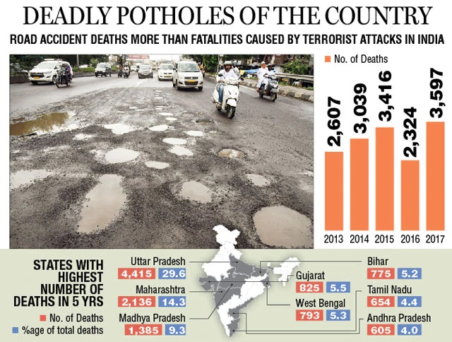
Some Eye Statistics

Slide 16
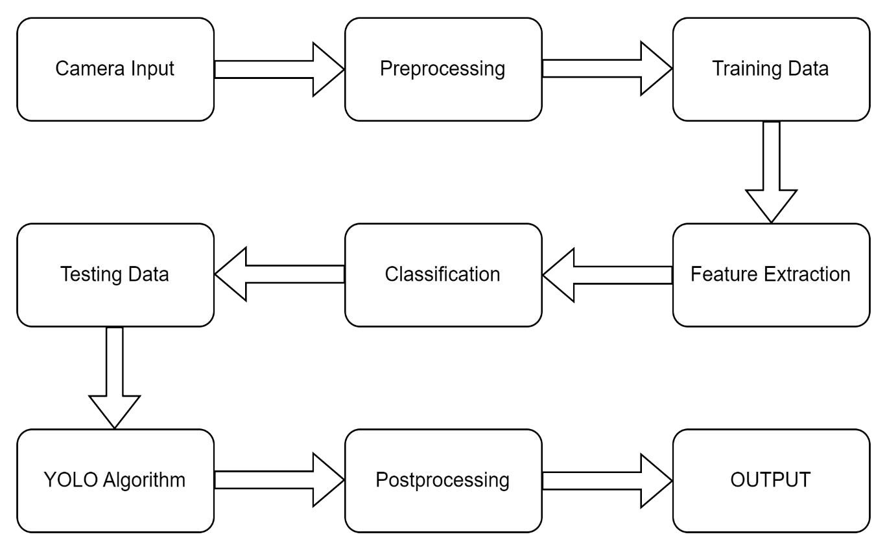
Block Diagram

Slide 17
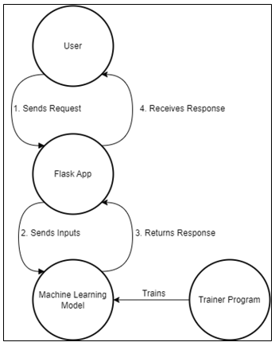
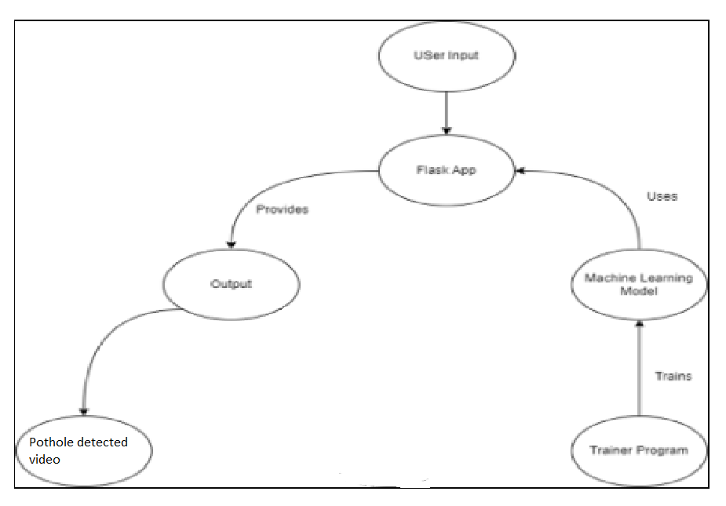
Workflow Diagram

Slide 18
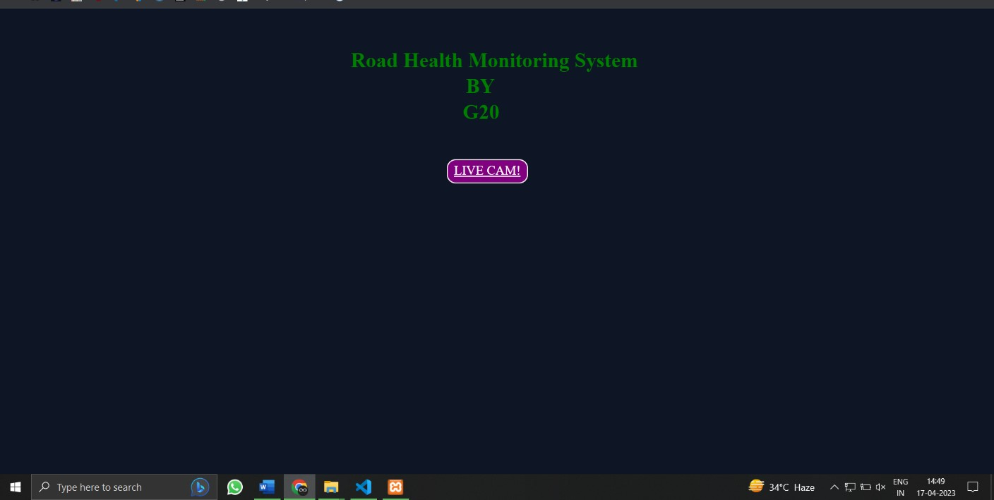
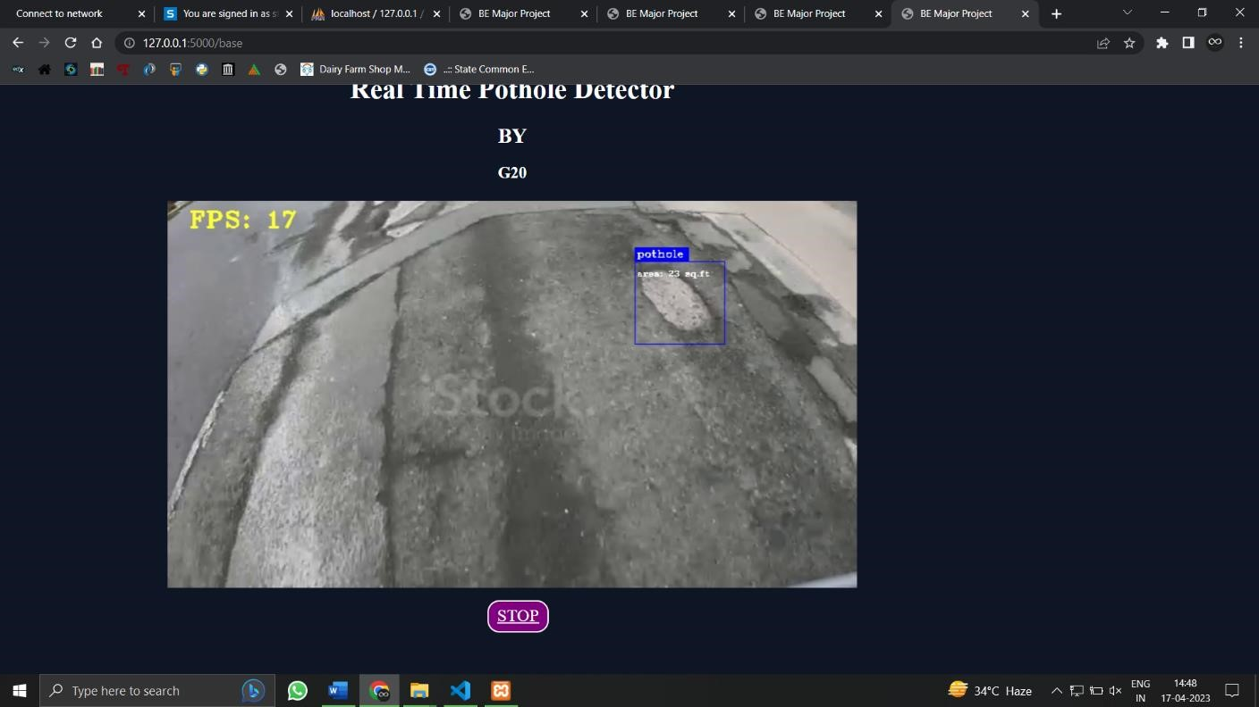
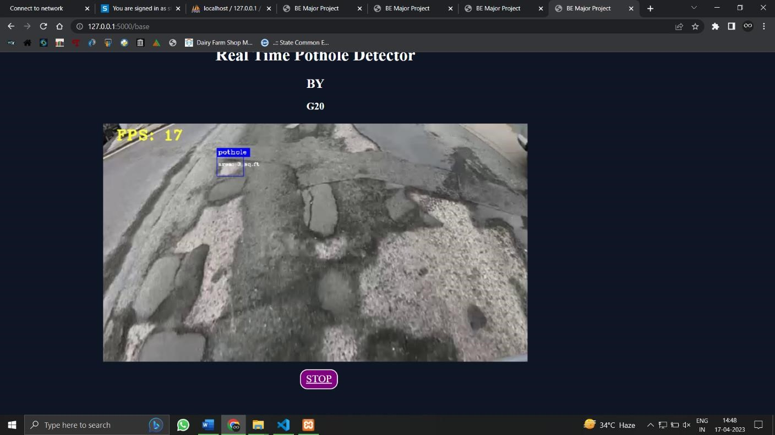
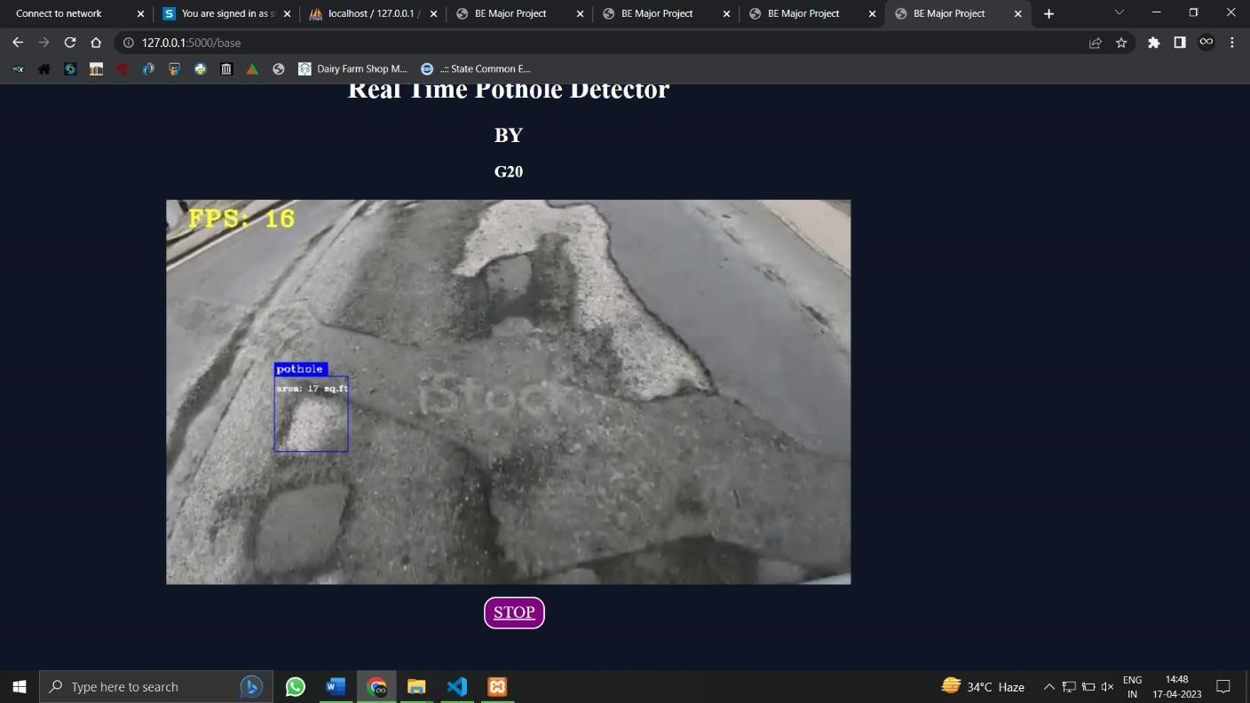
Results

Slide 19
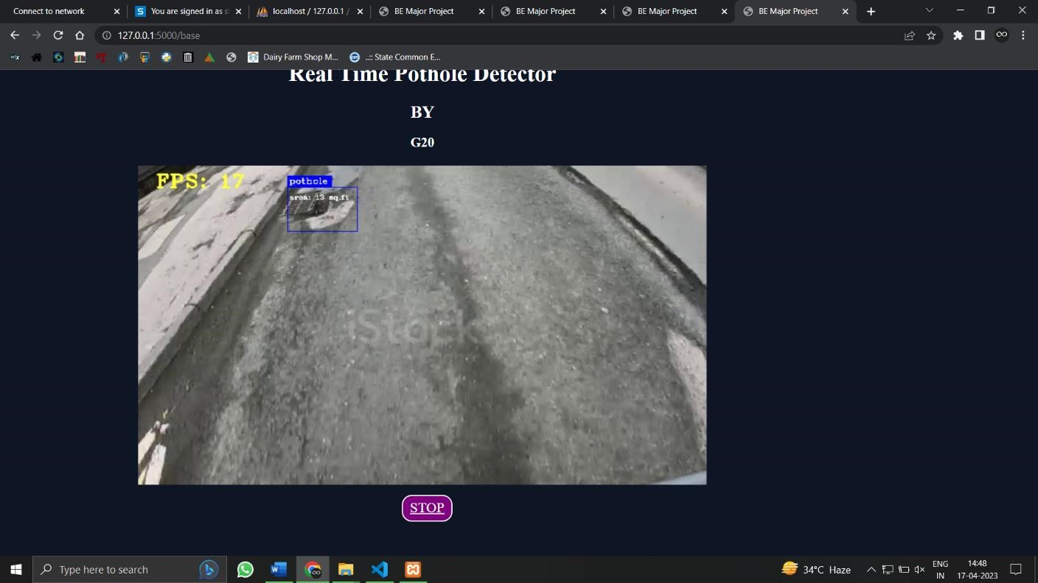
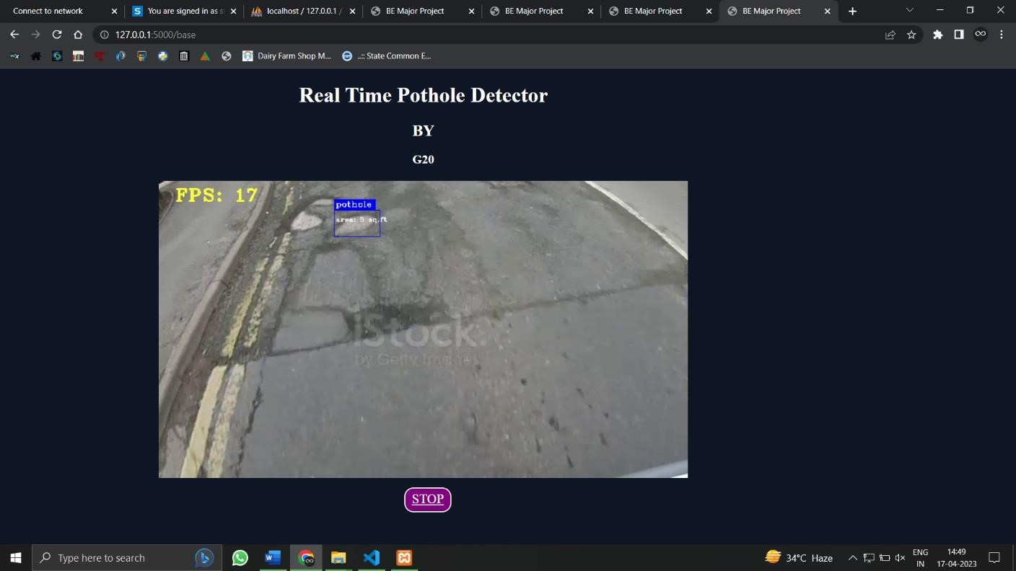
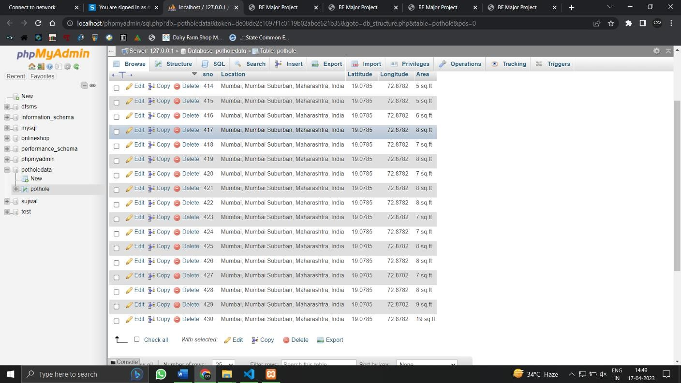
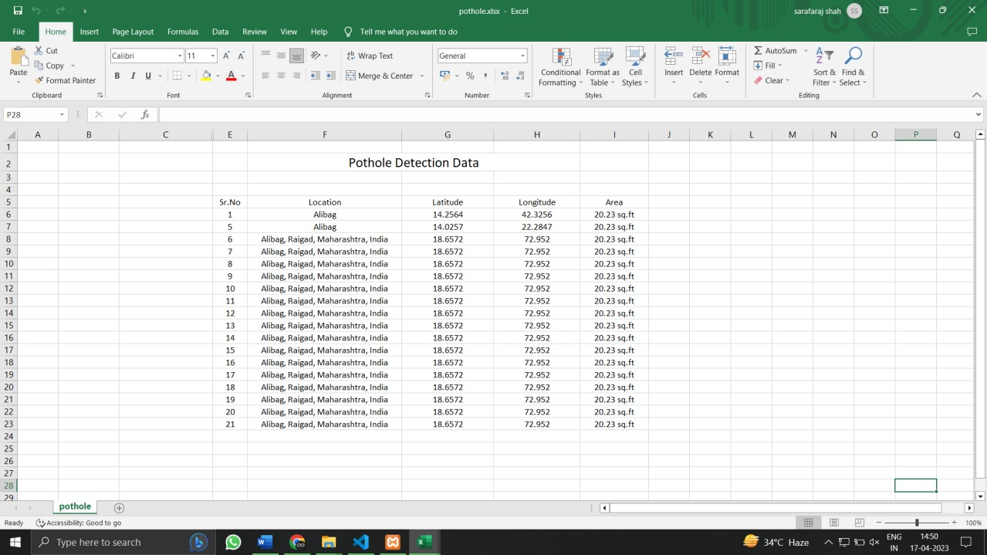
Results

Slide 20

Future Scope
Pothole Detection, a paradigm in Intelligent Transport sytem is mainly accompalished by Deep Learning based YOLOv4 algorithm. In this paper, a dataset of about 200 images is trained for detection of potholes and the average IoU of 38.38% is achieved. The image dataset based trained model is also successfully applied to video samples for the detection of potholes. In future, this concept can be applied to automobile industries, road maintenance authorities for detection of various road damages.

Slide 21
Conclusion
The proposed idea will help to reduce accidents and make driving safe.
It helps municipal administration to plan and act based on the notifications and public can keep a vigil on the performance of municipal administration in addressing the pothole complaints.
The hardware model is cost effective which is an added advantage.

Slide 22
References
https://www.researchgate.net/publication/323314224_Pothole_Detection_using_Machine_Learning
https://papers.ssrn.com/sol3/Delivery.cfm/SSRN_ID3865683_code4734722.pdf?abstractid=3865683&mirid=1
https://www.researchgate.net/publication/357909315_Detection_of_Roads_Potholes_using_YOLOv4
https://www.researchgate.net/figure/Pothole-detection-system-and-its-application_fig1_283188383
https://www.researchgate.net/figure/Pothole-detection-system-and-its-application_fig1_283188383
https://www.researchgate.net/publication/342578962_A_Road_Health_Monitoring_System_Using_Sensors_in_Optimal_Deep_Neural_Network

Slide 23
Borcelle
THANK YOU!

